Slide 1
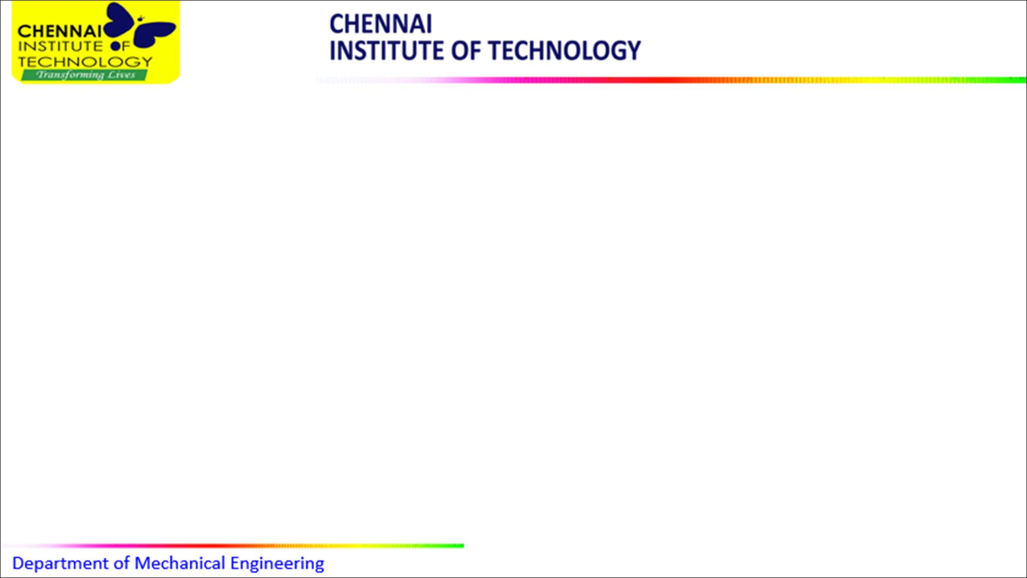

HARNESSING WASTE HEAT ENERGY
NAME OF THE SUPERVISOR
PROJECT MEMBERS
INTERNAL GUIDE:
Dr.R.VIJAYAN, M.E., Ph.D.,
Assistant Professor
Dept. of Mechanical Engineering
HEAD OF THE DEPARTMENT:
Dr.P.GURUSAMY M.E.,Ph.D
Dept. of Mechanical Engineering
DEPARTMENT OF MECHANICAL ENGINEERING
V.DHARANESH
CHENNAI INSTITUTE OF TECHNOLOGY
CHENNAI-600069
ME2305 – Core Course Project-1

Slide 2
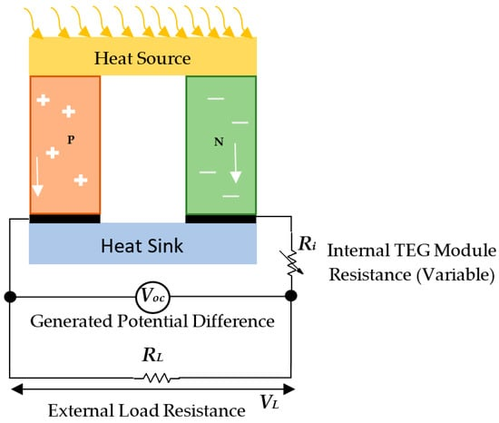
INTRODUCTION
THERMO-ELECTRIC GENERATOR
solid-state device
convert heat into electricity
Seebeck effect
Applications
Limitations
ME2305 – Core Course Project-1

Slide 3
ABSTRACT
This presentation introduces a comprehensive overview of our Thermoelectric Generator (TEG) project, which focuses on harnessing waste heat to generate electricity. Waste heat is an abundant and largely untapped energy source produced in various industrial processes, power plants, and automotive exhaust systems. Our TEG project explores the potential of converting this wasted thermal energy into useful electrical power using solid-state thermoelectric devices.
The primary focus of this project is to explore the diverse applications of TEGs. We explore waste heat recovery in industrial settings, where substantial amounts of energy are dissipated and wasted. Additionally, we examine how TEGs can be integrated into automotive systems to enhance vehicle efficiency and charge electronic devices.
ME2305 – Core Course Project-1

Slide 4
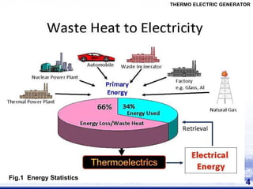
PROBLEM IDENTIFICATION
Low Efficiency
Material Limitations
Cost Considerations
Thermal Management
Size and Power Output
ME2305 – Core Course Project-1

Slide 5
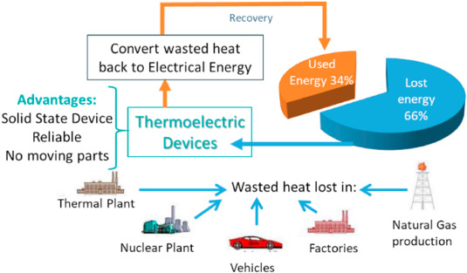
OBJECTIVE
Objectives:
Waste Heat Recovery
Clean and Sustainable Energy
Diversification of Energy Sources
Power Generation in Remote Locations
Wearable Electronics and IoT
Efficient Space Exploration
Industry and Automotive Efficiency
ME2305 – Core Course Project-1

Slide 6
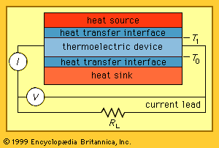
EXPERIMENTAL PLAN
Experimental plan:
Selection of TEG Modules
Heat Source
Cold Side Cooling
Data Acquisition System
ME2305 – Core Course Project-1 WORK

Slide 7
THANK YOU
ME2305 – Core Course Project-1

